Slide 1
Securing DB2 data – Part 2
Role & Trusted Context
- ParvathaVardhini Kannan

Slide 2
Role & Trusted CONTEXT:
A role is a database entity that groups one or more privileges together in a trusted context. System administrators can use roles to control access to enterprise objects in a way that parallels the structure of the enterprise.
A role is available only in a trusted context.
A trusted context is an independent database entity that can be defined based on a system authorization ID and connection trust attributes. The trust attributes specify a set of characteristics about a specific connection. These attributes include the IP address, domain name, or SERVAUTH security zone name of a remote client and the job or task name of a local client.
An authorization ID can have only one role in a trusted context at any given time
2

Slide 3
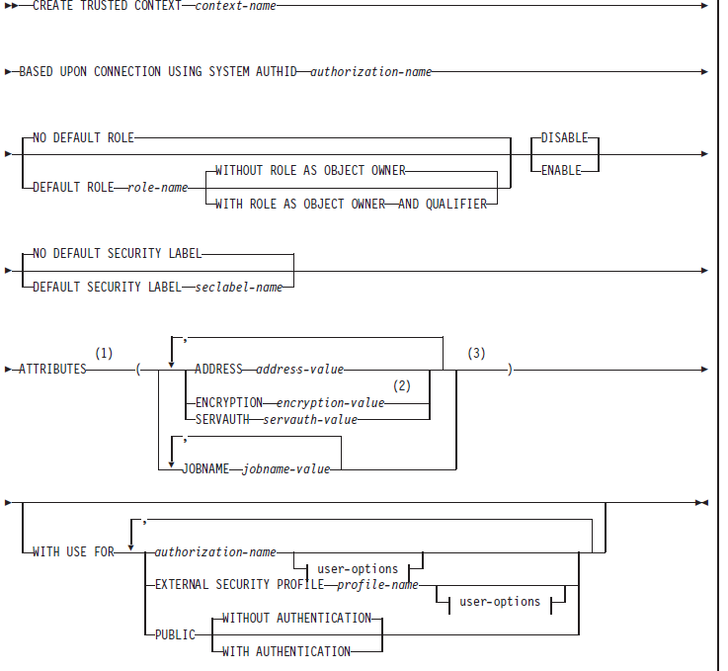

Slide 4
Role & Trusted CONTEXT:
CREATE ROLE rolename ;
For Remote Trusted connection :
CREATE TRUSTED CONTEXT CTX1
BASED UPON CONNECTION USING
SYSTEM AUTHID Authid1
ATTRIBUTES
(ADDRESS ‘n.nn.nn.nnn.nnn', ENCRYPTION 'LOW')
DEFAULT ROLE CTXROLE
ENABLE
WITH USE FOR UID1, UID2 ROLE ROLE1
WITH AUTHENTICATION;
4
Notes:
First one is for remote connection
Second one is when defining trusted context locally within mainframe.
WITH AUTHENTICATION, WITHOUT AUTHENTICATION etc.
The newly created trusted context takes effect after the CREATE TRUSTED CONTEXT statement is committed. If the CREATE TRUSTED CONTEXT statement results in an error or is rolled back, no trusted context is created.
The system AUTHID is the primary AUTHID used to establish the trusted connection.
Remote connection trust attributes: –SYSTEM AUTHID –ADDRESS –SERVAUTH –ENCRYPTION
Local connection trust attributes: –SYSTEM AUTHID –JOBNAME
4

Slide 5
Local Trusted CONTEXT:
CREATE TRUSTED CONTEXT CTX2
BASED UPON CONNECTION USING
SYSTEM AUTHID Authid2
ATTRIBUTES
(JOBNAME ‘TSOID')
DEFAULT ROLE CTXROLE
WITH ROLE AS OBJECT OWNER AND
QUALIFIER
ENABLE
WITH USE FOR UID3;
5
Notes:
First one is for remote connection
Second one is when defining trusted context locally within mainframe.
WITH AUTHENTICATION, WITHOUT AUTHENTICATION etc.
The newly created trusted context takes effect after the CREATE TRUSTED CONTEXT statement is committed. If the CREATE TRUSTED CONTEXT statement results in an error or is rolled back, no trusted context is created.
The system AUTHID is the primary AUTHID used to establish the trusted connection.
Remote connection trust attributes: –SYSTEM AUTHID –ADDRESS –SERVAUTH –ENCRYPTION
Local connection trust attributes: –SYSTEM AUTHID –JOBNAME
5

Slide 6
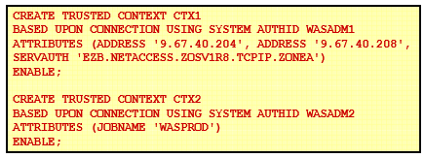
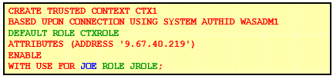
Create Trusted CONTEXT Examples:
6
Notes:
First one is for remote connection
Second one is when defining trusted context locally within mainframe.
WITH AUTHENTICATION, WITHOUT AUTHENTICATION etc.
The newly created trusted context takes effect after the CREATE TRUSTED CONTEXT statement is committed. If the CREATE TRUSTED CONTEXT statement results in an error or is rolled back, no trusted context is created.
The system AUTHID is the primary AUTHID used to establish the trusted connection.
Remote connection trust attributes: –SYSTEM AUTHID –ADDRESS –SERVAUTH –ENCRYPTION
Local connection trust attributes: –SYSTEM AUTHID –JOBNAME
6

Slide 7
New Functions
VERIFY_GROUP_FOR_USER
VERIFY_ROLE_FOR_USER
VERIFY_TRUSTED_CONTEXT_ROLE_FOR_USER
SESSION_USER or USER Specifies the value of the SESSION_USER (or USER) special register.
7
Notes:
7

Slide 8
Verifying the USERID / ROLE
SELECT SESSION_USER
FROM SYSIBM.SYSDUMMY1
;
SELECT ‘Indicator'
FROM SYSIBM.SYSDUMMY1
WHERE
VERIFY_TRUSTED_CONTEXT_ROLE_FOR_USER
(SESSION_USER,‘Rolename') = 1 ;
8

Slide 9
DROP ROLE rolename
When a role is dropped, all privileges and authorities that have been previously granted to that role are revoked. If the role that is dropped is the owner of statements in the dynamic statement cache, the cached statements are invalidated.
The role is not dropped if any REVOKE restrictions are encountered. REVOKE restrictions include the following:
Restrictions that are encountered when dependent privileges are included when the privileges of a role are revoked.
The role is the grantor of any privilege or authority that used ACCESSCTRL or SECADM authority to perform the grant.
9
Notes:
9

Slide 10
DROP ROLE Contd…
If RESTRICT is specified, the role is not dropped if any of the following dependencies exist:
The role is associated with any trusted context or any user in a trusted context.
The role is associated with a currently running thread.
The role is the owner of any of the following objects:
Alias , Column mask , Database , Distinct type , Index ,
JAR file, Materialized query table , Package , Role ,
Row permission , Sequence, Storage group,
Stored procedure, Table, Table space , Trigger,
Trusted context , User-defined function, View
10

Slide 11
DROP Trusted CONTEXT
When a trusted context is dropped, all associations to attributes (IP addresses, job names) and associations to users of the trusted context are dropped.
If the trusted context is dropped while trusted connections for the context are active, the connections remain active until they terminate or the next attempt at reuse is made.
11

